Slide 1
GUI CALCULATOR USING TKINTER LIBRARY
Presented by - ANAND KUMAR SINGH
E.Mail - 93anandsingh2011@gmail.com
Digicrome Academy | Data Science And AI

Slide 2
INTRODUCTION TO PYTHON
Python is a widely used general-purpose, high level programming language. It was created by Guido van Rossum in 1991 and further developed by the Python Software Foundation. It was designed with an emphasis on code readability, and its syntax allows programmers to express their concepts in fewer lines of code.
Python consistently ranks as one of the most popular programming languages, and has gained widespread use in the machine learning community.

Slide 3
ABOUT LIBRARIES IN PYTHON
Normally, a library is a collection of books or is a room or place where many books are stored to be used later. Similarly, in the programming world, a library is a collection of precompiled codes that can be used later on in a program for some specific well-defined operations. Other than pre-compiled codes, a library may contain documentation, configuration data, message templates, classes, and values, etc
Examples of python libraries-Pandas,Numpy,Matplotlib,Tenserflow,Scipy,Tkinter etc

Slide 4
ABOUT TKINTER
Tkinter is builtin the Python module for developing the GUI application. It's easy to use and comes with Python. We can visualize our data with GUI applications.
Tkinter is a standard Python GUI (Graphical User Interface) library that provides a set of tools and widgets to create desktop applications with graphical interfaces

Slide 5
How to create a simple GUI calculator
Import everything from the Tkinter using *.
Create an interface for the calculator.
Create an input function that enters a number into the input field.
Create an apparent function that wipes everything from the input field.
And finally, evaluate function that computes and gives the result of the expression.

Slide 6
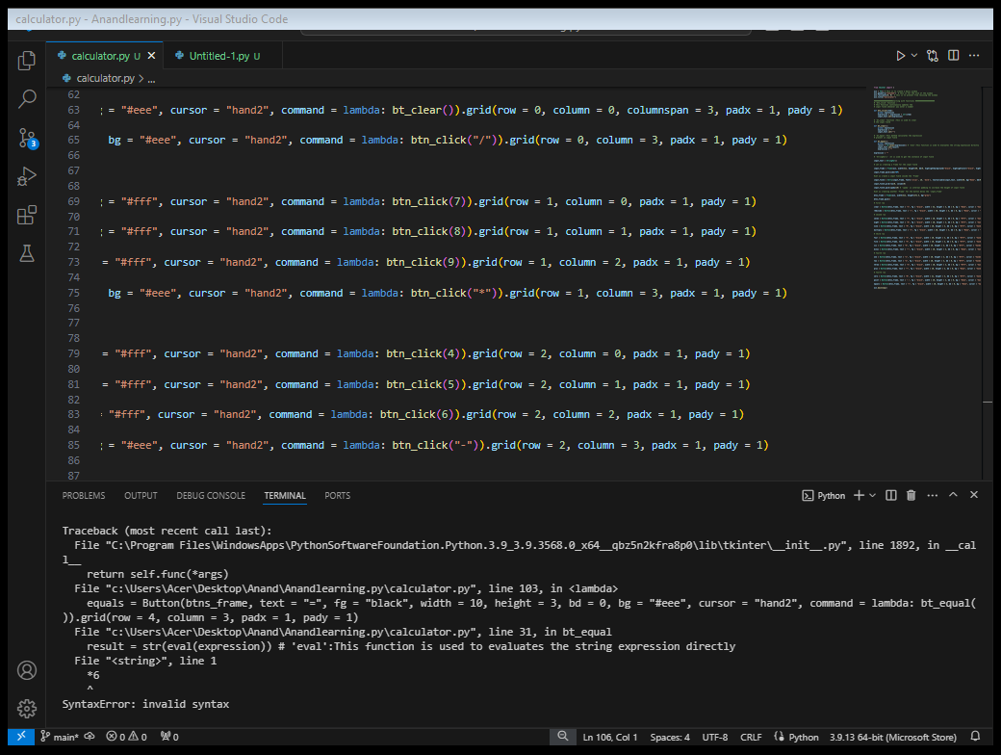
After performing the above methods in Vscode

Slide 7
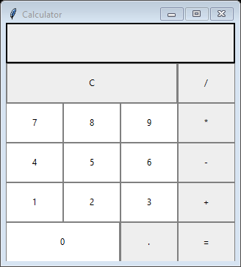
We get our simple GUI calculator as:

Slide 8
THANK YOU

